Slide 1
WebDiff Automated Identification of Cross-browser Issues in Web Applications
Shauvik Roy Choudhary,
Husayn Versee, and Alessandro Orso
Georgia Institute of Technology
Partially supported by the NSF awards CCF-0916605 and CCF-0725202 to Georgia Tech

Slide 2
Web Applications
Notes:
Web applications are ubiquitous. We use them in our day-to-day activities such as banking, shopping, networking, email, checking news and work. The advantage of web applications is due to their instant deployment and cross-platform compatibility. But are web applications truly cross-compatible? Let me show you an example.

Slide 3
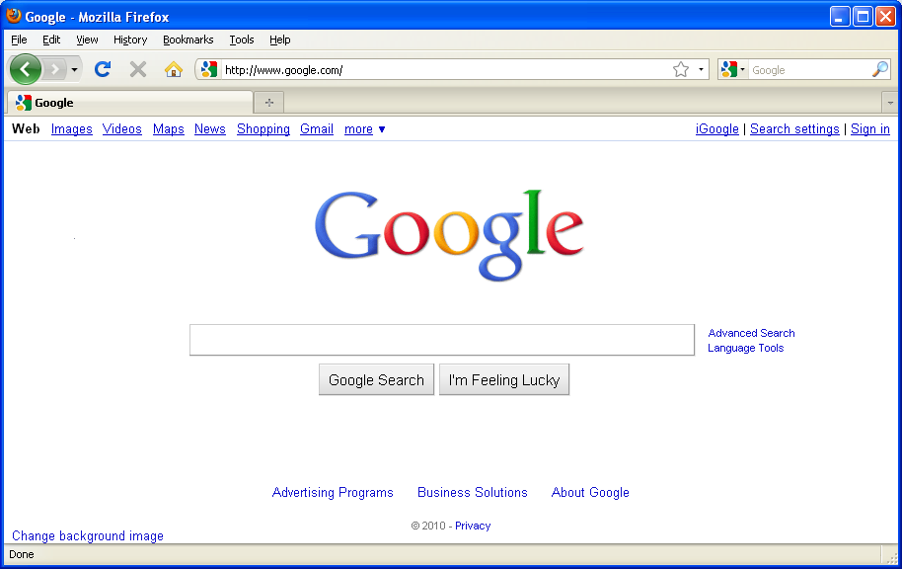
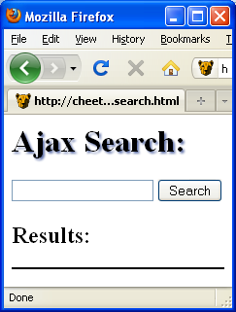
Motivating Example

Slide 4
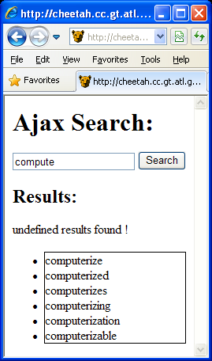
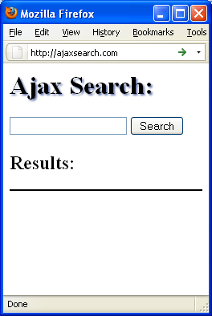
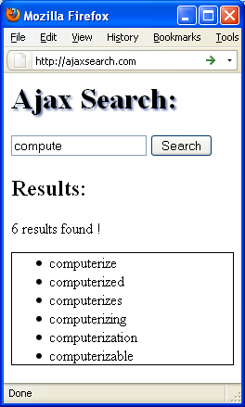
Motivating Example
<html>
<head>
<script src="script.js"></script>
<link href="style.css" rel="stylesheet" />
</head>
<body>
<h1>Ajax Search:</h1>
<input type="text" id="query" />
<input type="button" onclick="search()" value="Search" />
<h2>Results:</h2>
<div id="stats"></div>
<ul id="results"></ul>
</body>
</html>
document
HTTP Request
head
No shadow
body
HTTP Response
script
link
Server Side
(Web Application Server)
Result count
h1
input
input
h2
div
ul
Displaced border
Notes:
..This might be a toy example, but such problems are very common in real websites.

Slide 5
Georgia Tech Website
Mozilla Firefox
Internet Explorer
Notes:
One example close to our heart is the Georgia Tech website.

Slide 6
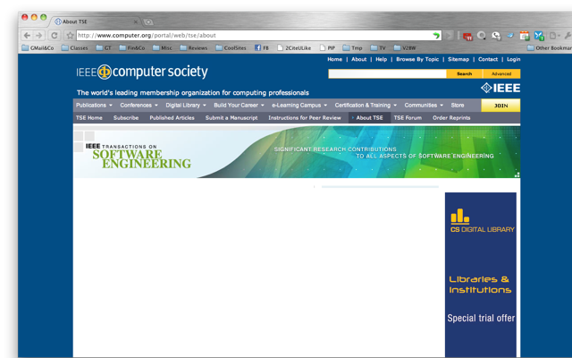
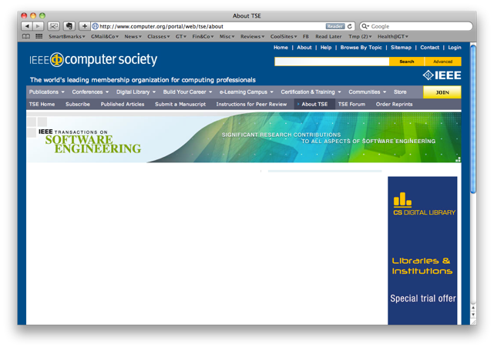
IEEE TSE Website

Slide 7
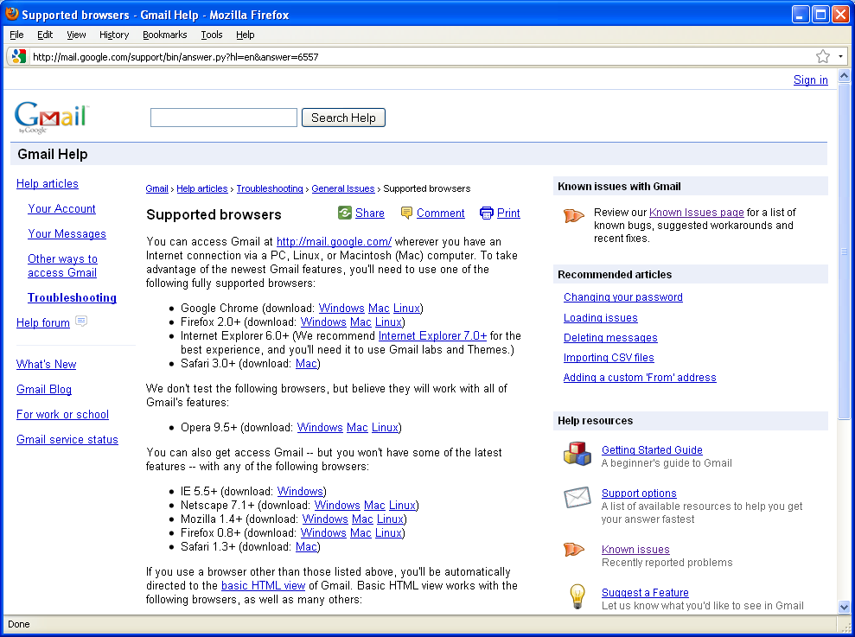
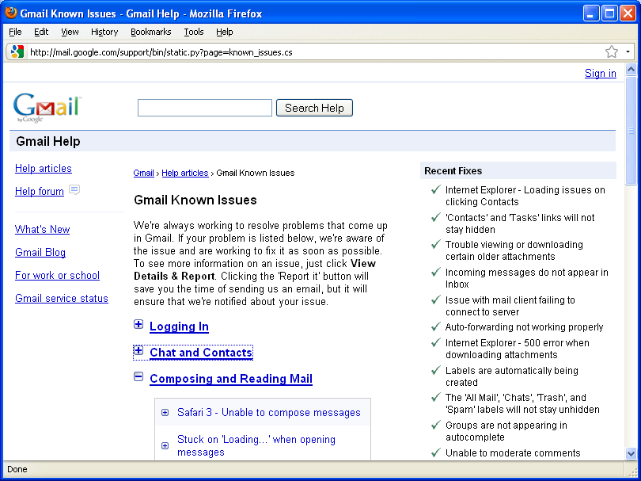
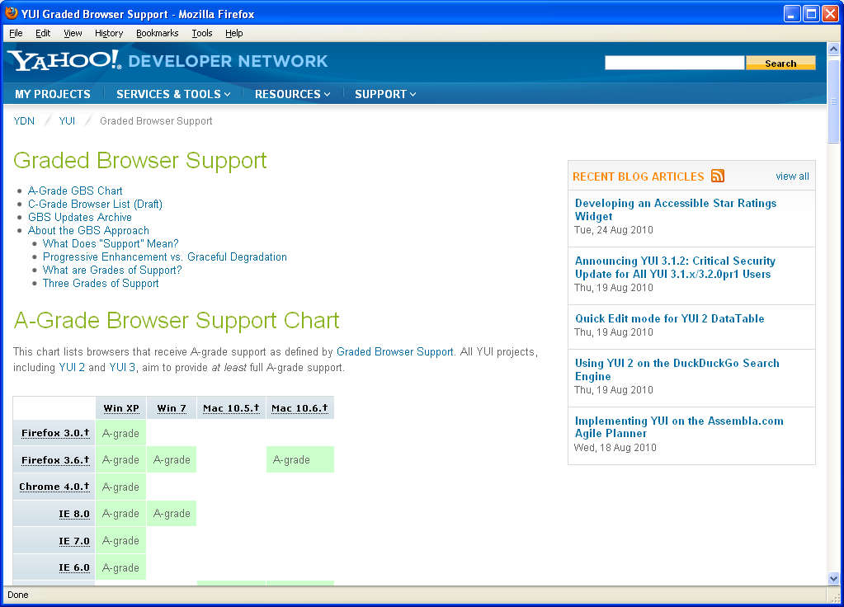
Commercial Services
Notes:
Companies Limit the number of browsers supported and are constantly struggling to fix bugs that appear with new browser versions and updates.

Slide 8
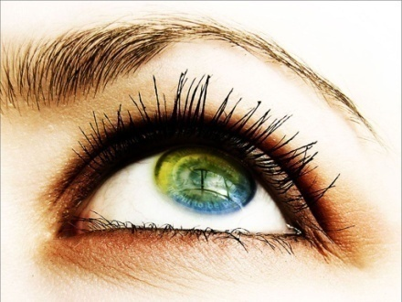
Challenges and Issues
Manual inspection
is expensive
DOM differs
between browsers
Mimic end user’s
perception
15 Sep 2010
3:15pm
Ignore variable elements
on webpage
Locate broken
element in code
Even work with
browser security controls
Notes:
It is tedious and time consuming to inspect all the web pages across all browsers manually. However current tools rely on manual inspection by developers for finding cross browser layout issues.

Slide 9
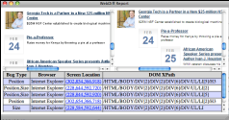
Our Technique
Goal: Compare behavior of web pages in different browsers
High level view of the approach:
Data collection
Ignore variable elements
Report
Structural analysis
Visual analysis

Slide 10
1. Data Collection
From each browser under consideration, the technique collects:
body
div
div
div
h1
a
ul
div
div
ul
div
div
div
div
div
Structural Information (DOM)
( tagname, id, xpath, coord, clickable, visible, zindex, hash )
Visual Information (Screenshot)

Slide 11
2. Detection of Variable Elements
Load page twice in reference browser:
body
body
div
div
div
div
div
div
h1
a
ul
div
div
h1
a
ul
div
div
ul
div
div
ul
div
div
div
div
div
div
div
div

Slide 12
2. Detection of Variable Elements
Page in reference browser over two subsequent requests:

Slide 13
3a. Cross-browser Comparison Structural Analysis
Match the nodes in the DOM tree of each browser to those in reference browser:
id = “footer”
id = “footer”
body
body
body
body
body
body
div
div
div
div
div
div
div
div
div
div
div
div
div
div
div
div
div
div
div
div
ul
div
div
h1
a
ul
div
h1
a
div
h1
a
ul
h1
a
ul
div
div
ul
div
ul
div
ul
div
div
div
div
ul
div
div
div
div
div
div
div
div
div
div
div
tagname = “div”
id = null
div
div
div
div
div
div
div
div
div
xPath1 = /html/body/div[1]/div[1]/div[1]
xPath2 = /html/body/div[1]/div[1]/div/div[1]
tagname = “div”
id = null

Slide 14
3b. Cross-browser Comparison Visual Analysis
Type of issues found:
Positional shifts
Size differences
Visibility differences
General appearance issues

Slide 15
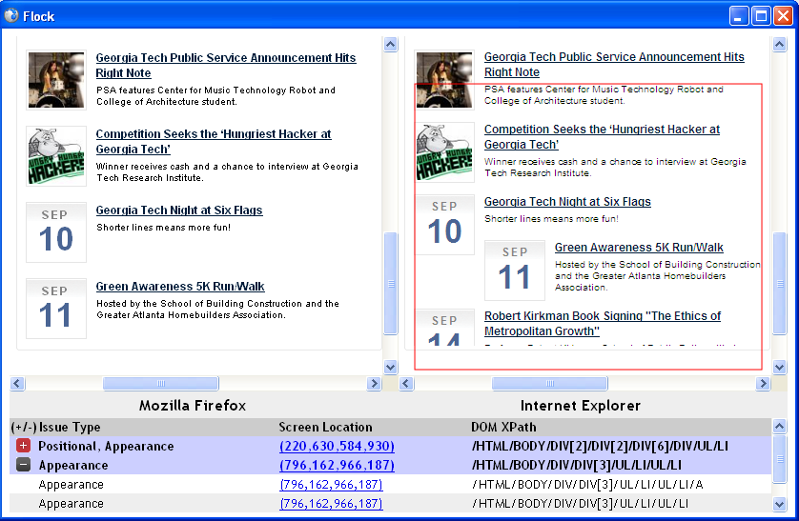
Produced Report
Reference Browser screenshot
Target Browser screenshot

Slide 16
Empirical Evaluation
RQ1 : Can WebDiff identify cross-browser issues in web applications?
RQ2 : Can WebDiff identify such issues without generating too many false positives?
Notes:
RQ1:
RQ2:

Slide 17
Experimental Settings
Test Subjects
Subject Name | URL | Type
GATECH | http://www.gatech.edu | University
BECKER | http://www.beckerelectric.com | Company
CHESNUT | http://www.chestnutridgecabin.com | Lodge
CRSTI | http://www.crsti.org | Hospital
DUICTRL | http://www.duicentral.com | Lawyer
JTWED | http://www.jtweddings.com | Photography
ORTHO | http://www.otorohanga.co.nz | Informational
PROTOOLS | http://www.protoolsexpress.com | Company
SPEED | http://www.speedsound.com | E-Commerce
For each page P and browser B considered
Load P in B and in the reference browser
Compare the page in the two browsers using our technique
Store the produced reports
Manually checked for false positives and false negatives

Slide 18
Results
Subject | # Issues Reported |  |  |  |  | False Positives | False Negatives
 | Pos. | Size | Vis. | Gen. | Tot.
GATECH | 2 | 3 | 0 | 1 | 6 | 0 (0%) | 0
BECKER | 2 | 12 | 0 | 3 | 17 | 1 (6.25%) | 0
CHESNUT | 8 | 4 | 0 | 4 | 16 | 2 (14.3%) | 0
CRSTI | 4 | 4 | 0 | 2 | 9 | 0 (0%) | 0
DUICTRL | 9 | 8 | 0 | 6 | 23 | 4 (21%) | 0
JTWED | 3 | 9 | 0 | 1 | 14 | 0 (0%) | 0
ORTHO | 0 | 0 | 0 | 4 | 4 | 2 (100%) | 0
PROTOOLS | 4 | 5 | 0 | 11 | 20 | 9 (81%) | 0
SPEED | 23 | 5 | 0 | 5 | 33 | 3 (10%) | 0
TOTAL | 55 | 50 | 0 | 37 | 142 | 21 (17%) | 0
Notes:
False Positives due to (1) Elements with text and background images (2) Unidentified variable elements

Slide 19
Results
Subject | # Issues Reported |  |  |  |  | False Positives | False Negatives
 | Pos. | Size | Vis. | Gen. | Tot.
GATECH | 2 | 3 | 0 | 1 | 6 | 0 (0%) | 0
BECKER | 2 | 12 | 0 | 3 | 17 | 1 (6.25%) | 0
CHESNUT | 8 | 4 | 0 | 4 | 16 | 2 (14.3%) | 0
CRSTI | 4 | 4 | 0 | 2 | 9 | 0 (0%) | 0
DUICTRL | 9 | 8 | 0 | 6 | 23 | 4 (21%) | 0
JTWED | 3 | 9 | 0 | 1 | 14 | 0 (0%) | 0
ORTHO | 0 | 0 | 0 | 4 | 4 | 2 (100%) | 0
PROTOOLS | 4 | 5 | 0 | 11 | 20 | 9 (81%) | 0
SPEED | 23 | 5 | 0 | 5 | 33 | 3 (10%) | 0
TOTAL | 55 | 50 | 0 | 37 | 142 | 21 (17%) | 0
Notes:
False Positives due to (1) Elements with text and background images (2) Unidentified variable elements

Slide 20
Results
Subject | # Issues Reported |  |  |  |  | False Positives | False Negatives
 | Pos. | Size | Vis. | Gen. | Tot.
GATECH | 2 | 3 | 0 | 1 | 6 | 0 (0%) | 0
BECKER | 2 | 12 | 0 | 3 | 17 | 1 (6.25%) | 0
CHESNUT | 8 | 4 | 0 | 4 | 16 | 2 (14.3%) | 0
CRSTI | 4 | 4 | 0 | 2 | 9 | 0 (0%) | 0
DUICTRL | 9 | 8 | 0 | 6 | 23 | 4 (21%) | 0
JTWED | 3 | 9 | 0 | 1 | 14 | 0 (0%) | 0
ORTHO | 0 | 0 | 0 | 4 | 4 | 2 (100%) | 0
PROTOOLS | 4 | 5 | 0 | 11 | 20 | 9 (81%) | 0
SPEED | 23 | 5 | 0 | 5 | 33 | 3 (10%) | 0
TOTAL | 55 | 50 | 0 | 37 | 142 | 21 (17%) | 0
RQ1 (Effectiveness): No false negatives in test subjects
RQ2 (Efficiency): False positive rate of 17%
Notes:
False Positives due to (1) Elements with text and background images (2) Unidentified variable elements

Slide 21
Related Work
Industrial Tools
Adobe Browser Lab & MS Expression Web
Require manual inspection
Browsera (launched Summer 2010)
Simple DOM matching (from experience using the tool)
Research Tools
Eaton & Memon [IJWET07]
Requires manual classification. Limited to html tags only
Tamm [GTAC09]
Expensive and is focused on layout of text elements

Slide 22
Summary
Notes:
So, in summary – we looked at a motivating example, certain challenges and issues for detecting cross browser issues automatically, I presented my technique to identify these issues automatically and concluded with results which were encouraging.
Future work
Improve the technique & tool based on user feedback.
Perform additional experiments.
Investigate ways to further reduce false positives.

